Slide 1
The Construction Industry: PGTI best practices for growing and retaining a diverse building trades workforce
Mary Vogel
Executive Director, Building Pathways
Eastern Seaboard Apprenticeship Conference
May 18, 2022

Slide 2
Our Mission
Recruit, retain and advance diverse workers in the union building trades, including women, people of color, and other under-served groups.
Integrated supply and demand strategy:
Supply: Creating a Pipeline of diverse workers
Demand: Promoting policies and practices that create employment and advancement opportunities for diverse workers

Slide 3
5 Pillars of Work
Pre-Apprenticeship Training
Outreach to Diverse Communities
Respectful Workplaces
Childcare for Nonstandard Hours
Advocacy

Slide 4
1978
President Carter issues Executive Order 11246 requiring that 6.9% of hours worked on federally-funded projects be worked by women. At that time, less than 3% of tradespeople were women.
2022
In 2022, women made up just 4% of construction workers in the U.S

Slide 5
PGTI: the Policy Group on Tradeswomen’s Issues - What is it?
A multi-stakeholder construction industry collaboration including tradeswomen, building trades unions, contractors and developers, government representatives, community organizations
75 active industry partners
Have met every other month for 13 years

Slide 6
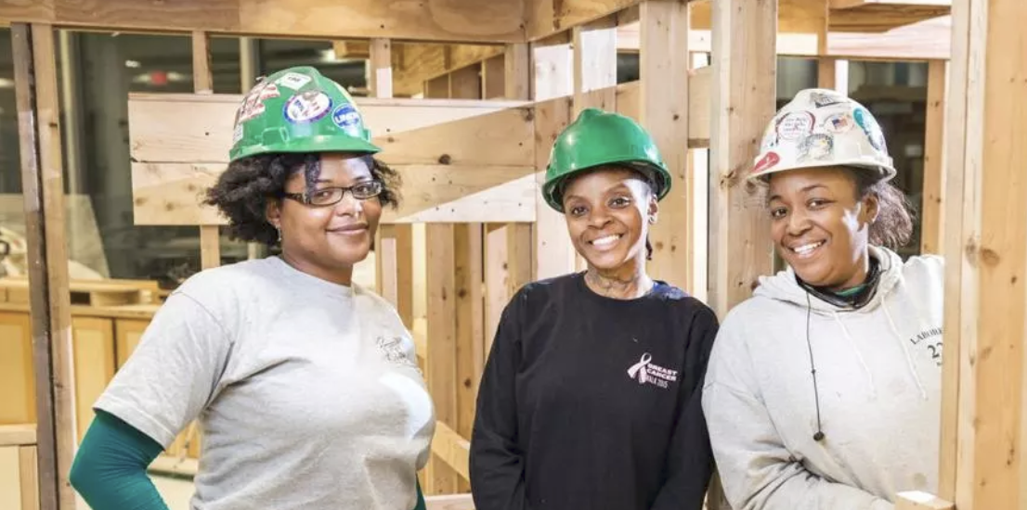
PGTI’s mission
Crushing the barriers to
women’s entry into the construction trades
Spreading best practices for gender diversity to our regional construction industry

Slide 7
We stopped asking WHY.

Slide 8
5 game changers
Collaborate across stakeholder groups.
Integrated Supply and Demand Strategy.
Make tradeswomen visible.
Set high targets. Count and report.
Lead from where you are.
Adapted from the “5 Tips” included in Getting it done: Utilising women’s skills in the workforce: Lessons from the Canterbury rebuild (August 2015). Canterbury had 17% tradeswomen on their post-earthquake rebuild.

Slide 9
Multi-stakeholder collaboration at every level
Unions
Apprenticeship programs
Community groups
Educators
Government
Contractors
Subcontractors
Owners and developers– public and private
We build strategic learning communities for change
Notes:
SUSAN Best practices thru GC for contractors

Slide 10
GAME CHANGER
✓Supply
Women want and need these jobs for the same reasons men do.
Notes:
It’s the right thing to do.
It’s the law.
Labor shortage and market share

Slide 11
Supply - Pre-Apprenticeship Training
5 union-affiliated programs in MA:
Building Pathways Boston
Building Pathways South
Building Pathways Worcester
Community Works
SkillsBuild
Prepare diverse participants to enter into a registered apprenticeship program
473 participants; 90% women and/or BIPOC; 86% placement

Slide 12
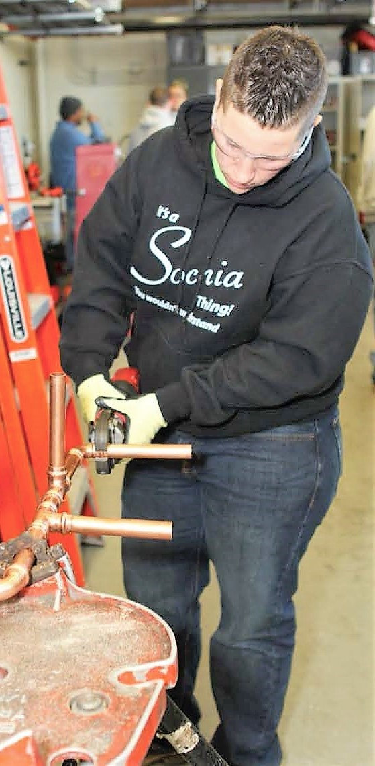
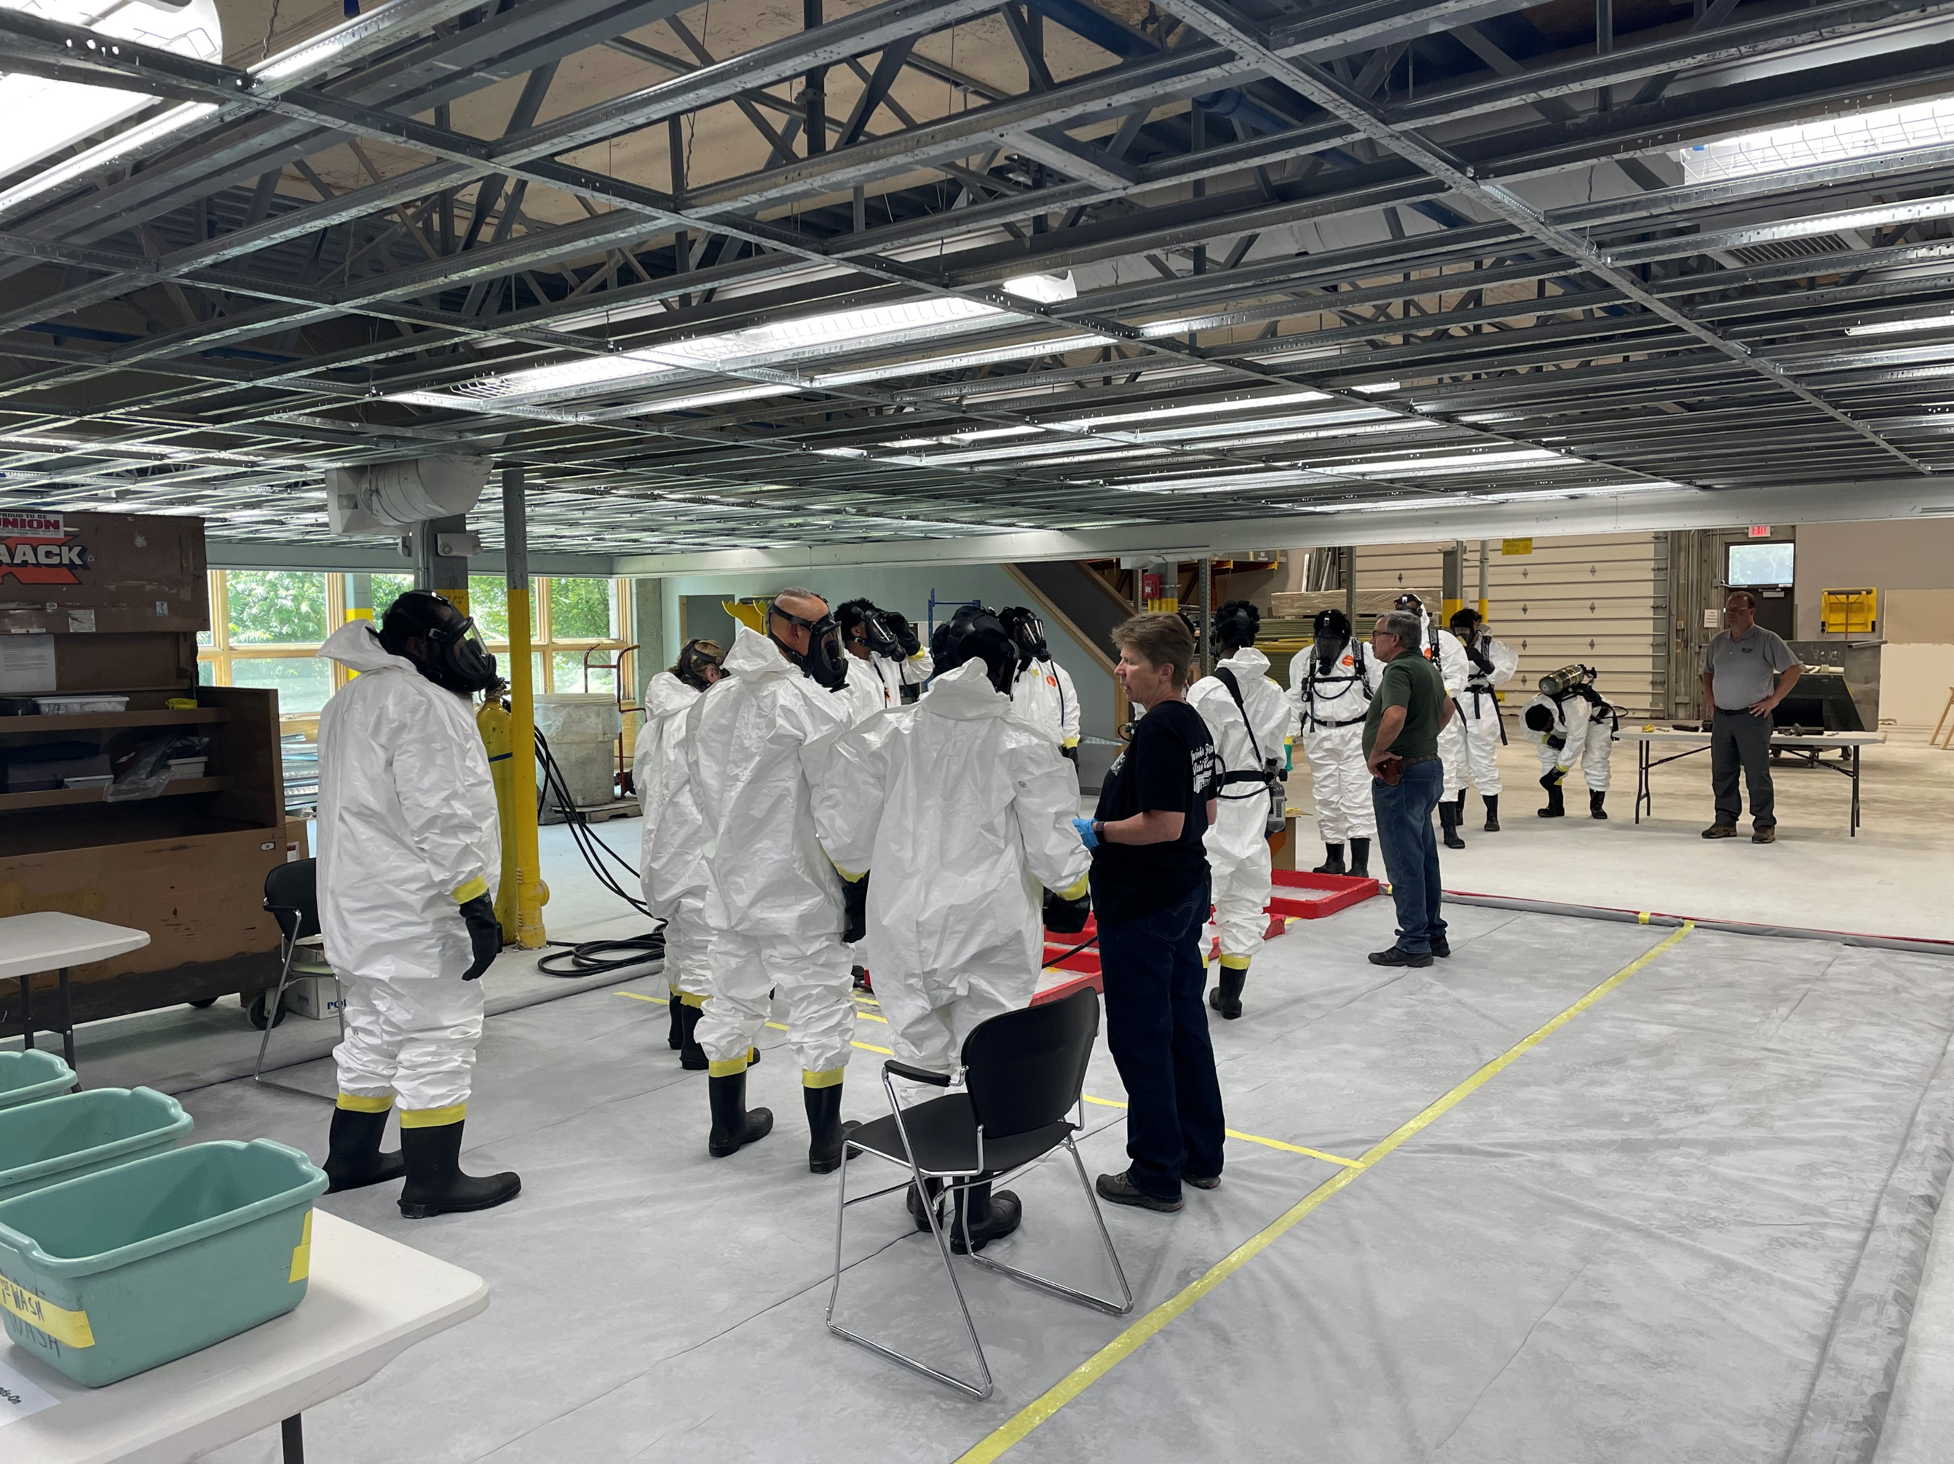
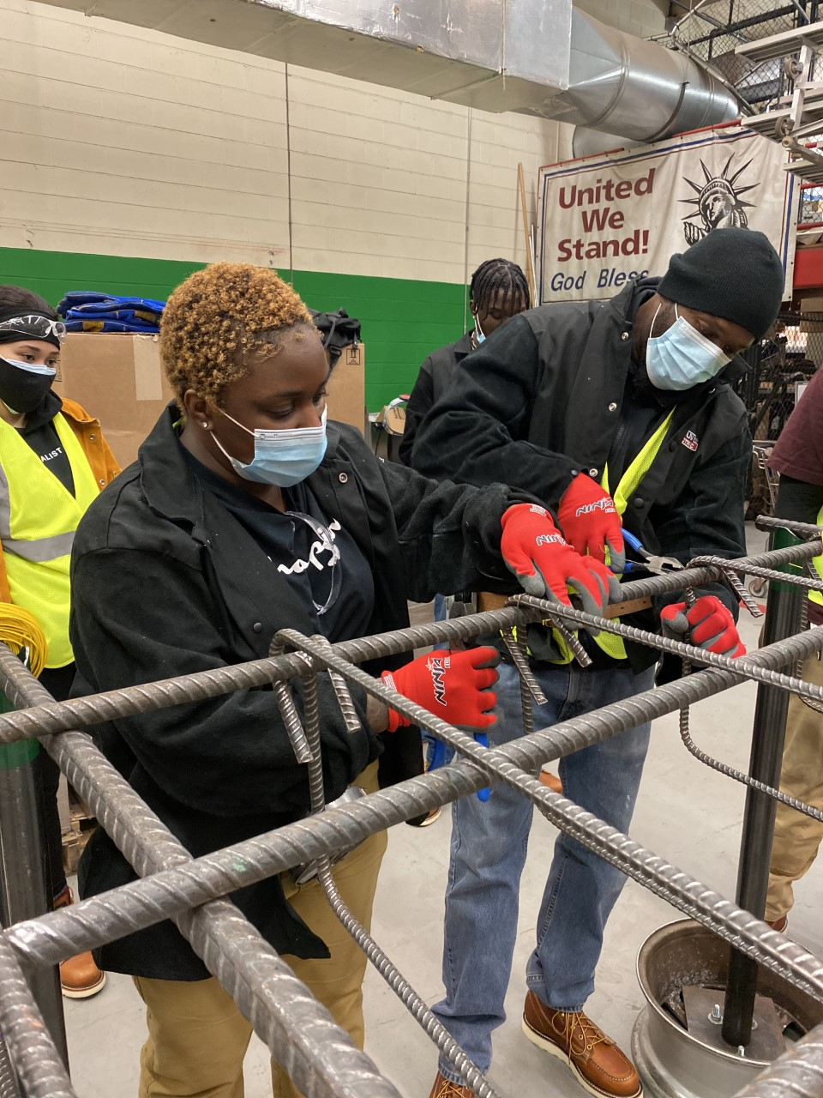
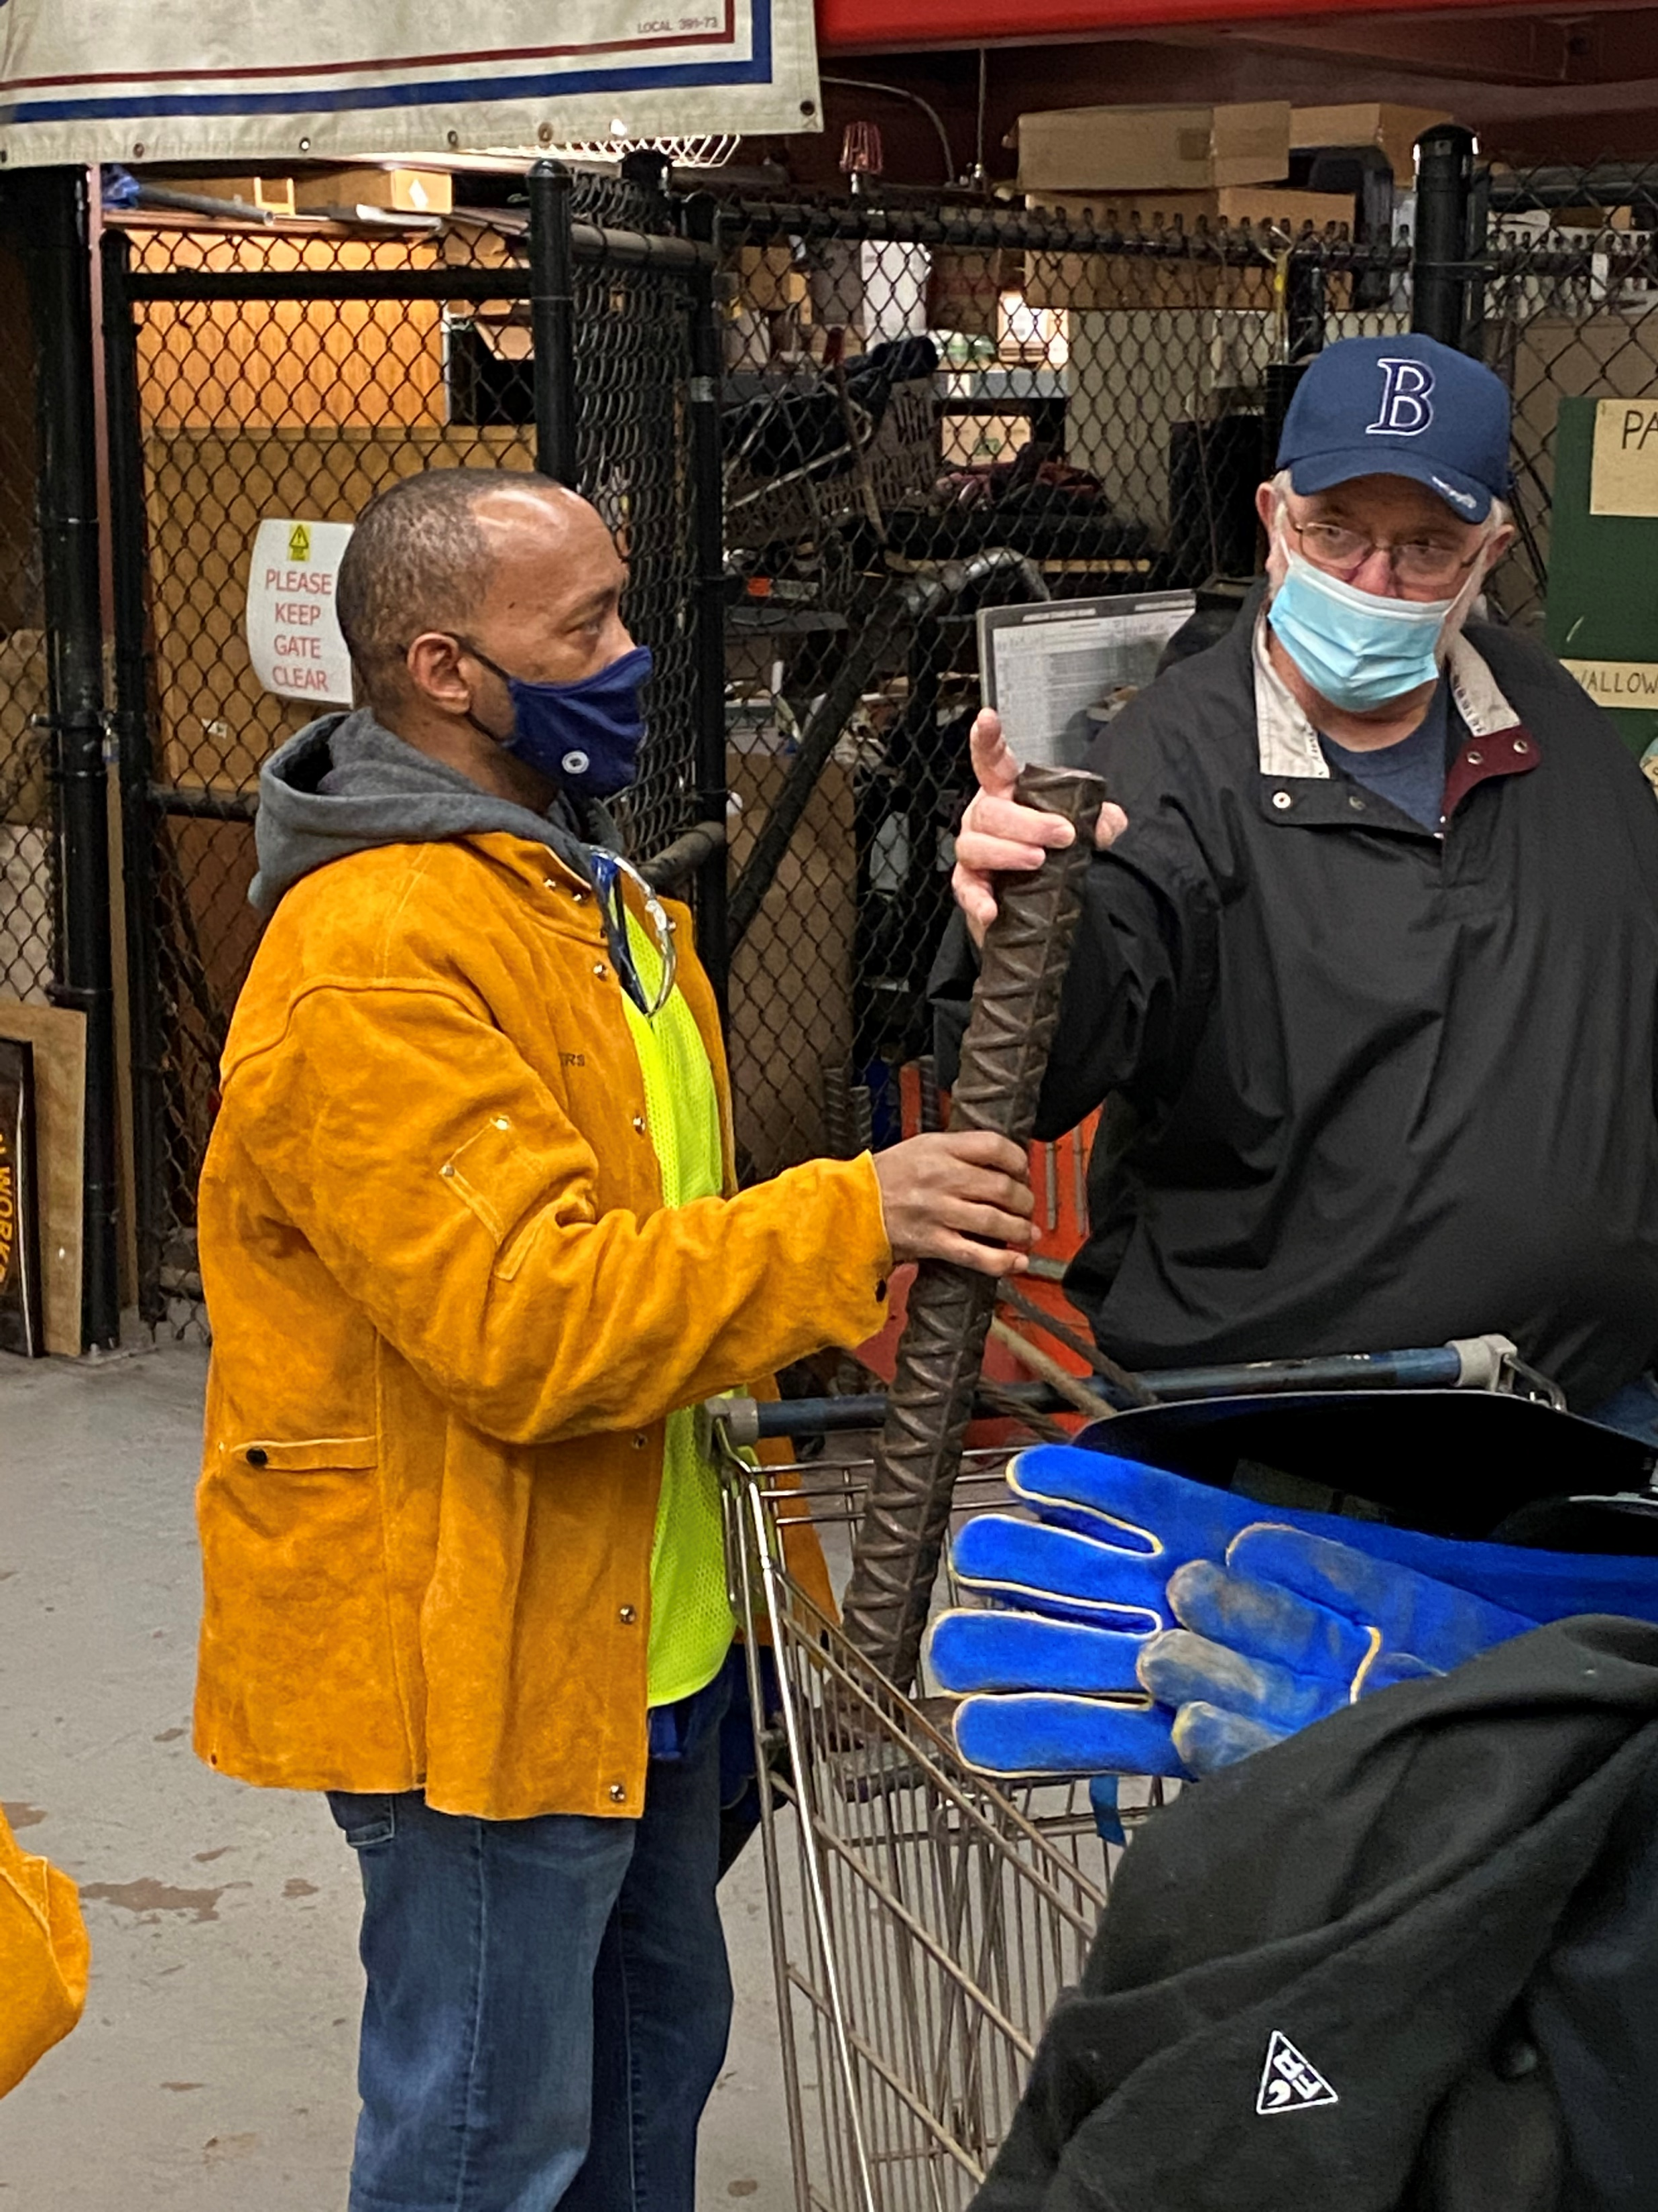
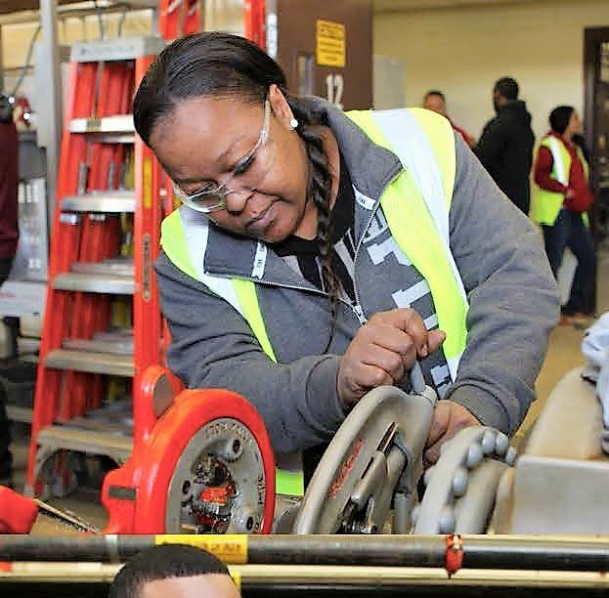

Slide 13
Supply: Build A Life That Works
Education campaign to expose women to careers in the building trades
Heighten the visibility of tradeswomen
Connect women career seekers to tradeswomen
GPS not Uber

Slide 15
Make Tradeswomen Visible - If You Can See It You Can Be It

Slide 17
Build A Life That Works Results

Slide 18
Supply: High Schools
High School Road Show
MA Girls in Trades
Collaboration of Career Tech Ed High Schools, Unions, Contractors
Encourage young women in Vocational High Schools to pursue careers in the union building trades
Conference & Career Fair
Equity in the Trades Student Leadership Councils
Engagement with guidance counselors and educators

Slide 19
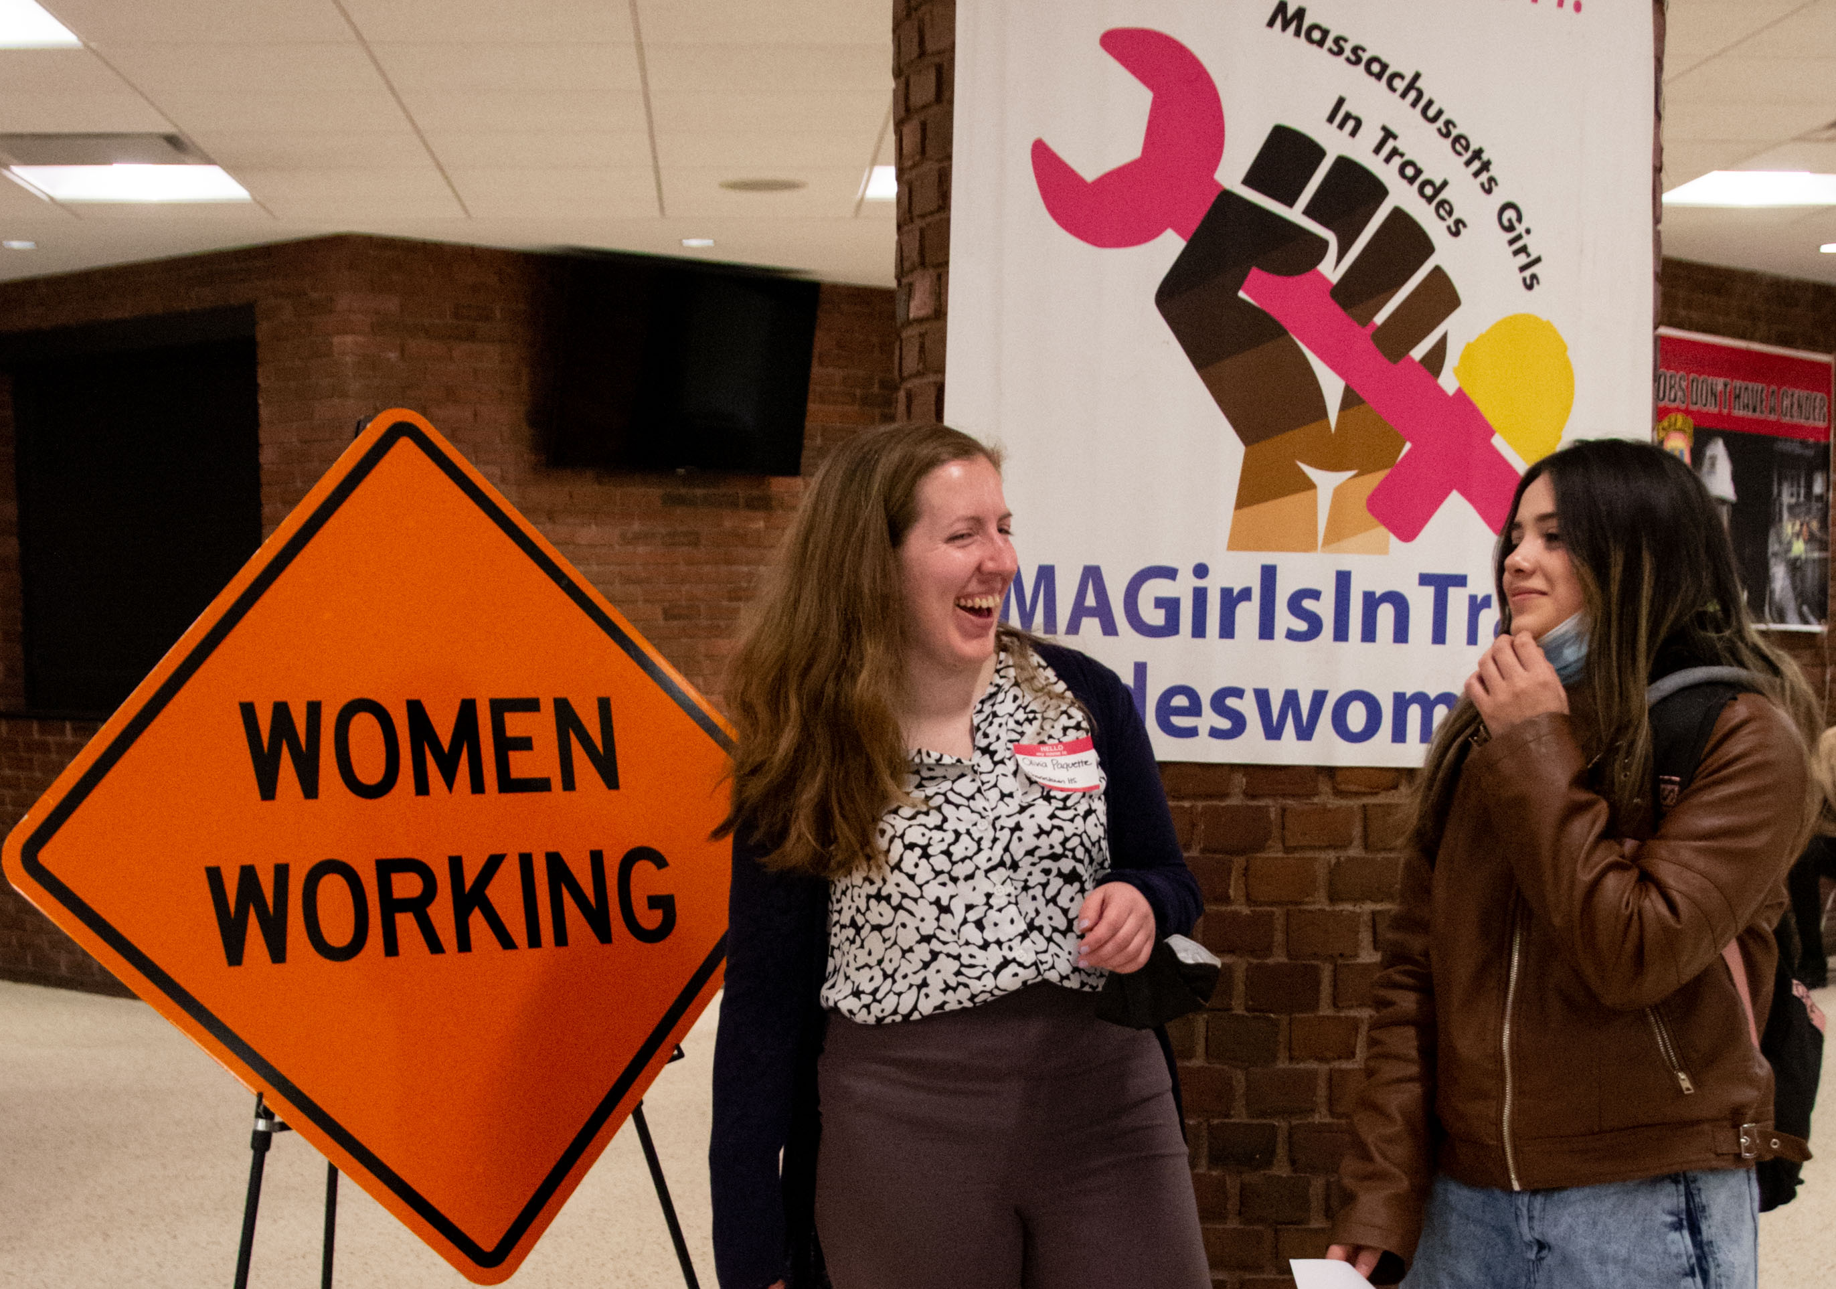
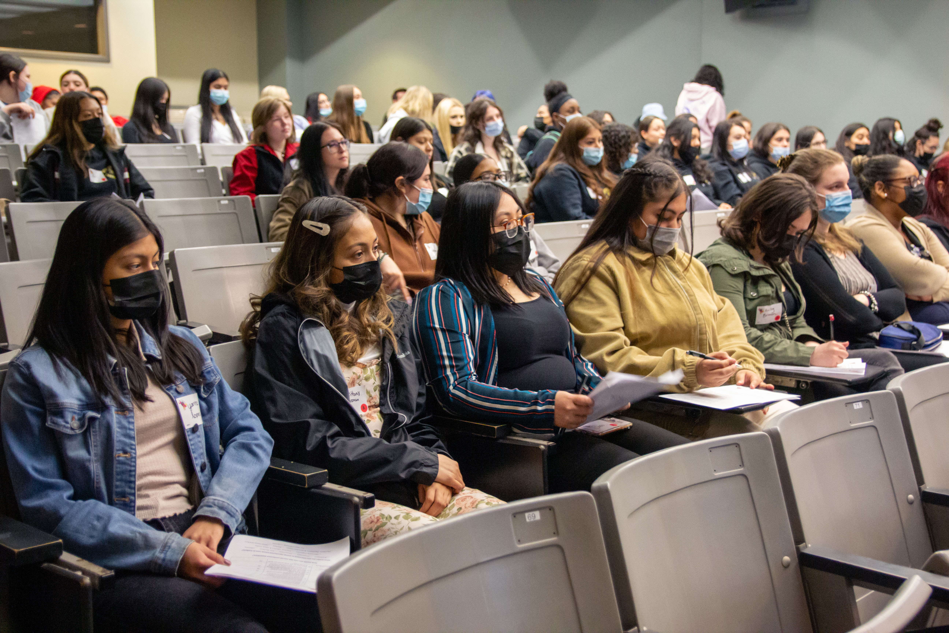
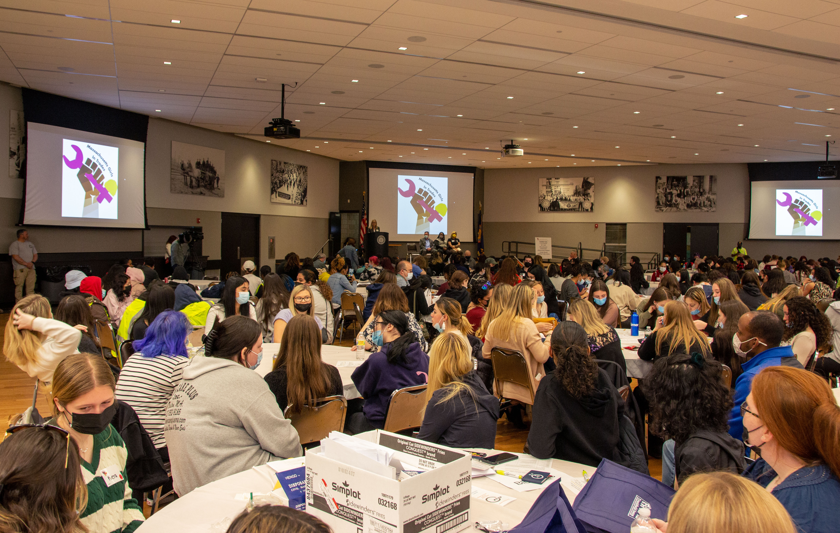

Slide 21
Best Practices to Create Demand for Diverse Workers - Policy Group on Tradeswomen’s Issues

Slide 22
Best Practices to Create Demand for Diverse Workers
Set workforce participation goals – set high targets
Count and report - implement internal compliance infrastructure to monitor and adjust course
Access and Opportunity Committees – multi-stakeholder group led by GC/CM
REVIEW: diversity compliance across the project and for every subcontractor, focusing on high impact, poor performers.
CORRECTIVE ACTION: plans and other best practices to ensure the project meets or exceeds goals for a diverse workforce, including frequent meetings with non-compliant subcontractors.
LEARNING COMMUNITY: members develop strong working relationships, recognize that they are in a unique learning environment and grow to share a commitment to making real change in an important industry
Diverse core crews
Crush barriers to success
Respectful Workplace
Child Care

Slide 23
Retention of Diverse Workers
2021 Institute for Women’s Policy Research - “A Future Worth Building – What Tradeswomen Say about the Change They Need in the Construction Industry.”
Survey of over 2600 tradeswomen and non-binary tradespeople reflecting on their experience in the industry.
Over 44% of IWPR respondents reported that they left or seriously considered leaving the trades. Although there are a number of reasons, lack of respect or discrimination was the most cited reason.

Slide 24
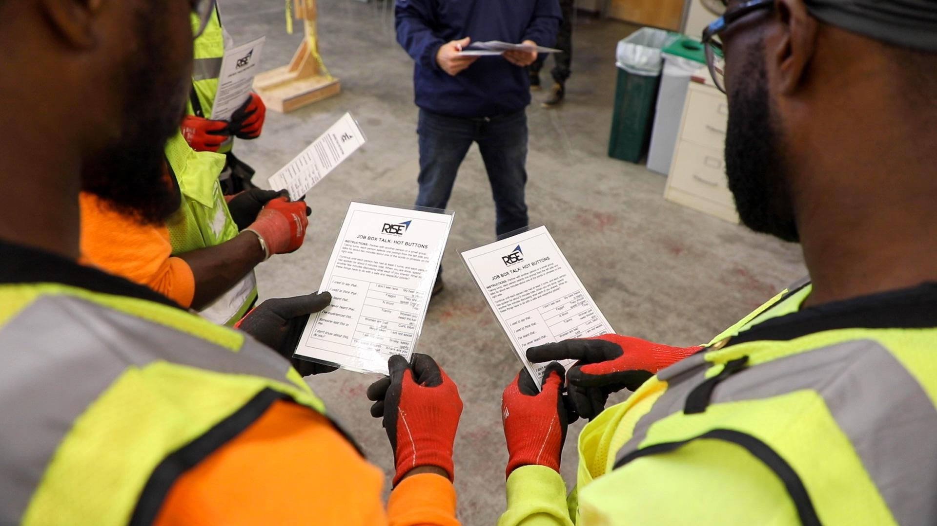
Knowledge, Tools And Skills For Creating a Respectful Workplace
Respect, Inclusion, Safety and Equity
Notes:
[If doing a virtual training, please go the jamboard, make a copy of it. Then rename it with the Date Manager Skills. Use this during your presentation. Share the link to the new jamboard! If you share this one, the template will have to be recreated. https://jamboard.google.com/d/1wJO-IwHdyCiluM0E9jMhCxOY-vW2MtbEctLYAtTJX8g/edit?usp=sharing]
Welcome to the Respectful Workplace Training where you will gain knowledge, tools and skills for creating a respectful and inclusive work site.
This training is for any individual playing a supervisory or management role on a job site or for a job. This can include project managers, foreman, superintendents, of the contractor, sub-contractors or owners.

Slide 25
Construction-hours child care now available!
Pilot program in Boston area working with licensed family child care providers to offer child care starting at 5 or 5:30am
Child care providers all accept childcare vouchers, their weekly rates vary
Scholarships for families without vouchers of $100/week for 6 months paid to provider for tuition discount
Notes:
So here are some of the nuts and bolts of the pilot program:

Slide 26
Lead From Where You Are
What is within your power to make the change?

Slide 27
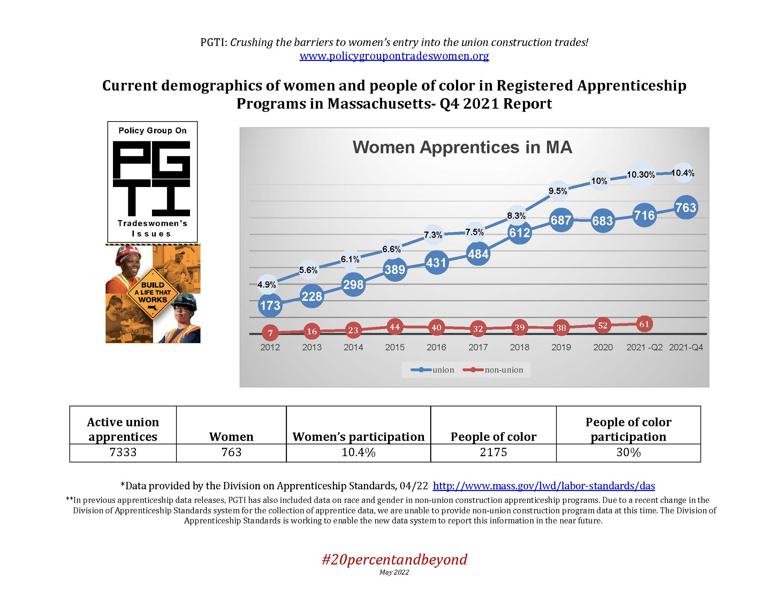

Slide 28
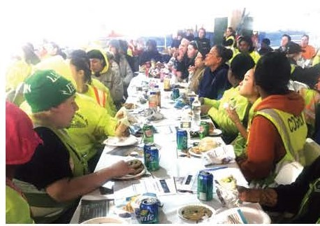
Encore Casino – 497 Tradeswomen

Slide 29
Contact
Mary Vogel, mary@buildingpathwaysma.org;
413-237-5507

